Slide 1
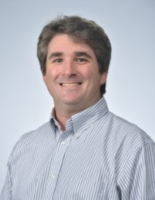
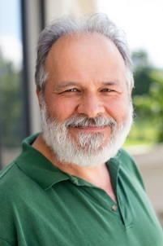
Leading Your ACS
Local Section
Jason Ritchie, Chair,
Committee on Local Section Activities (LSAC)
2018 Pre-Leadership Institute Webinar: Preparing You to be a Successful Chair/Officer
January 9, 2018, 1:00—2:00 p.m.
This webinar transcript and slides and will be posted to www.acs.org/getinvolved.
Tracy Hamilton,
Subcommittee Chair,
Operations and Support
Notes:
The American Chemical Society has more than a dozen committees of its Council where a tremendous amount of the governance work of the ACS takes place.
The Committee on Local Section Activities, commonly known as LSAC is one of those standing committees.
It has 20 full committee members and 8 associate members, together with various staff liaisons who provide invaluable guidance to the committee.
The role of LSAC is defined in our mission statement:
[to] “work with local sections to enhance their success, to promote the well-being of their members, to foster the spirit of volunteerism, and to carry out the mission of the American Chemical Society at the professional and community level”
The roles of LSAC are quite numerous but include are covered by our self-described motto “Help Local Sections be all they want to be”.
We oversee the design and processing of the Annual Reports, and mine the accompanying data, that are to be submitted by 15th February each year,
nurture local section leaders through professional development opportunities within the ACS and
develop programs and opportunities that allow local sections to stimulate initiatives for their members

Slide 2
WEBINAR AGENDA
Jason Ritchie:
The Committee on Local Section Activities
“Nuts and Bolts” for Leading Your Section
Tracy Hamilton:
Local Section Leadership
Ellen Stechel:
Local Section Communication and ACS Resources
Greg Milligan:
LSAC Grants and Awards
Jason Ritchie:
Leadership Institute Overview
Q&A and Comments
Notes:
I will be presenting the first portion of the webinar today by introducing the work of the Committee on Local Section Activities and some “Nuts and Bolts” for leading your section.
Tracy will then take you through in some more detail how on effective leadership in your local section is a driving force for the success that you wish to see, and of course to make ACS membership rewarding and fun with local colleagues.
Then Ellen will discuss communications in your local sections, and some resources that the ACS provides to help you successfully communicate with your members,
Then Greg will discuss Grants and Awards that are available from LSAC to help you successfully run programs in your local section.
Then, I’ll be back to give you an overview of what to expect at the Leadership Institute next week.

Slide 3
The Committee on Local Section Activities
Jason Ritchie, 2018 Chair LSAC

Slide 4
COMMITTEE ON LOCAL SECTION ACTIVITIES (LSAC)
What: A Standing Committee of the Council
  20 full committee members
  8 associate members
Role: Assist, nurture, inspire, support, and recognize Local Sections
  Help local sections to be all they want to be
  Process/Design Annual Reports and assist with mining the data
  Stimulate LS programs and initiatives
  Address general development needs
  Professional development of new leaders
  ChemLuminary Awards
Notes:
ADD

Slide 5


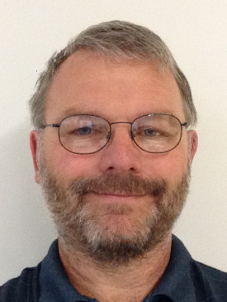
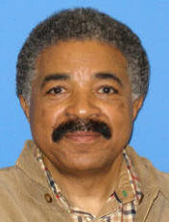
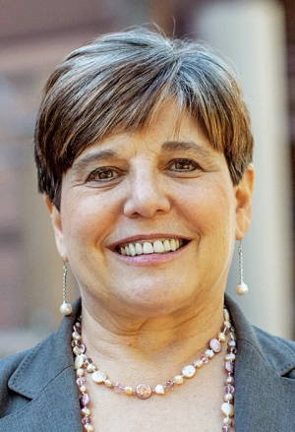
SUPPORT FOR LOCAL SECTIONS
Committee on Local Section Activities—Executive Committee
Jason Ritchie, LSAC Chair, jritchie@olemiss.edu
Greg Milligan, Subcommittee Chair, Grants & Awards, gmilligan@stmartin.edu
Tracy Hamilton, Subcommittee Chair, Operations & Support, hamilton@uab.edu
Charles Cannon, Subcommittee Chair, Communications, ccannon@colum.edu
Ellen Stechel, Subcommittee Chair, Technology & Tools, ellen.stechel@asu.edu
Notes:
Here is the 2017 executive committee of LSAC. Jason Ritchie is chair this year.
Greg Milligan is the chair of the Grants and Awards subcommittee of LSAC
Ellen Stechel is chair of the Technology and Tools subcommittee,
Charles Cannon is the chair of the Communications Subcommittee,
And Tracy Hamilton is the Chair of the Operations and Support Subcommittee,
All of the LSAC Executive Committee are here to assist you.

Slide 6
“Nuts and Bolts” for
Leading Your Section
Jason Ritchie, 2018 Chair LSAC
Notes:
You might be new to your local section, you might have served in different volunteer roles previously but today you are learning about helping to lead your local section. Thank you for your willingness to participate in this webinar and for agreeing to attend the Leadership Institute in Dallas next week
When a member joins the ACS, there are initially assigned to a local section based on their zip code. Members can however choose to join any local section.
Some local sections assign dues, which is in addition to ACS annual membership.
The strength of the ACS’ local sections comes from the uniqueness of the sections.
Their characters have been determined through years of serving members based on the location, size, the institutions contained within their borders and their resources.
Through years of working with local sections, LSAC has developed some very basic, yet common, characteristics that underlie successful sections.
Among them, recognize the members that make up your section and devise programs for their diversities.
Have a strong shared infrastructure and provide your ACS local section with a home.

Slide 7
“NUTS AND BOLTS” FOR LEADING YOUR SECTION
What is an ACS local section?
  All members are initially assigned (based on zip code) but may opt to join another section
  Local Section dues are set by each section
Every section is different
  Based on size, location, institutions, resources, etc.
  Offers opportunities for uniqueness
Successful sections share common characteristics
  Focus on members, students, community
  Devise programs for each cohort
  Have strong, shared infrastructure
  Provide a local ACS home
Notes:
Organized by zip codes

Slide 8
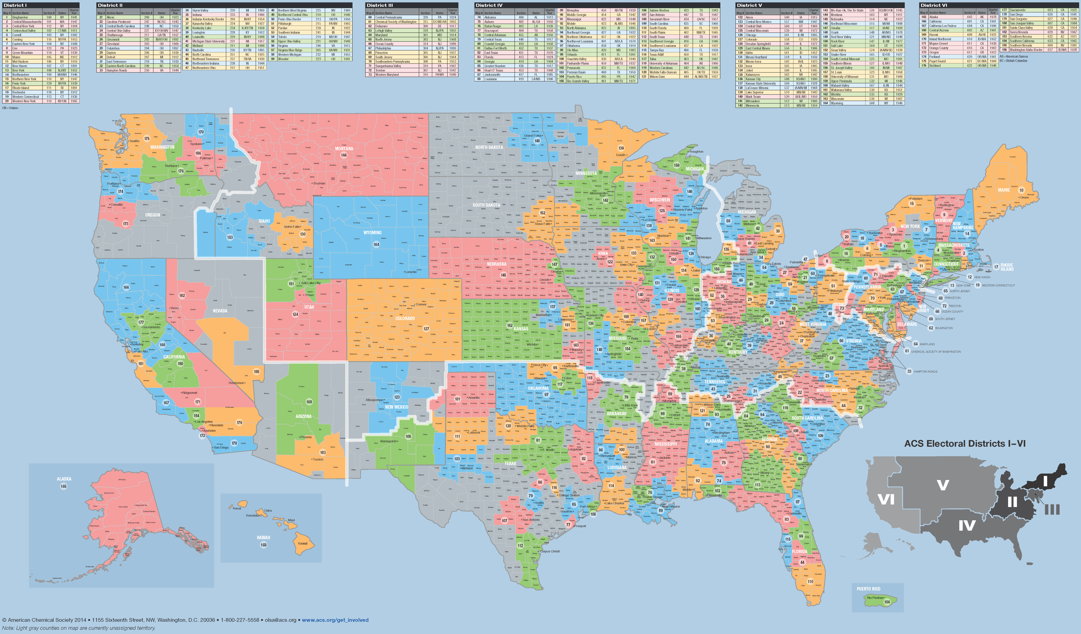
ACS Local Sections: We are EVERYWHERE
Small: 54 Medium Large: 20
Medium Small: 46 Large: 13
Medium: 45 Very Large: 7
Notes:
ACS Local Sections are Everywhere.
As you can see from the map, the ACS local sections are spread all across the country, and are split into six regions (based on membership numbers).
At the Leadership Institute, you will have a chance to meet some of your neighboring, regional sections during the Friday afternoon program.
Involvement of ACS members, at the local section level, helps the ACS achieve its six strategic goals

Slide 9
LOCAL SECTION TIDBITS
184 local sections
Smallest: Penn-York
Largest: Northeastern
First local Section: Rhode Island (1891)
Youngest Local Section: Snake River (2007)
Number of Sections Celebrating Milestone 2018 Anniversaries:
  125 Years: Chemical Society of Washington, Lehigh Valley
  100 Years: None
  75 Years: Carolina-Piedmont, Lake Superior, Sabine-Neches
  50 Years: Heat o’Texas, LaCrosse-Winona, Northeast Georgia
Notes:
Local Section Tidbits:
With local sections categorized according to the sizes shown on the previous slide, we always have something to celebrate among the 184 sections.
Our largest is Northeastern and our smallest is Penn-York.
We have several local sections celebrating significant anniversaries this year
125 Years
Chemical Society of Washington
Lehigh Valley
75
Carolina-Piedmont
Lake Superior
Sabine-Neches
50
Heart o'Texas
LaCrosse-Winona
Northeast Georgia
We hope they have something special planned for this year to mark these anniversaries!

Slide 10
ACS LOCAL SECTION REQUIREMENTS
  Submit an Annual Report
    February 15th
    Annual Reports are submitted using FORMS (www.acs.org/forms)
    Administration and Financial forms are required
    Event forms are highly recommended
      provide documentation of section activities!
    Event forms are required for awards
    Hold annual elections
      Review your section’s Bylaws for specific processes, dates, etc. for your section
      Report the election results to ACS by December 1st
Notes:
ACS Local Section Requirements
Local sections are required to submit an annual report each year by 15th February.
That successful and complete submission triggers the release of the annual allotment.
Annual Reports are submitted via a comprehensive web interface system call FORMS.
FORMS is available year round and is accessed through your ACS log in and password.
A financial and administration form is required, including a local section budget.
Highly recommended are event forms that outline the events and activities held in your local section for members, or that engage other community interest groups.
The flexible format enables you to upload photons, weblinks, videos, and especially useful, is the fact that this can be done at any time of the year.
I recommend that your local section keeps up with these as you complete the events rather than leaving them all to annual report time.
Templated outlines make the task simple.
Local sections can self-nominate events for a host of ChemLuminary award recognitions.
A second requirement is to hold elections each and every year for elected officer positions.
You own local section bylaws will guide you to the specific processes and dates [bylaws are available for all sections at acs.org].
Results of the elections need to be reported to the ACS by 1st December.

Slide 11
Local Section Leadership
Tracy Hamilton, Subcommittee Chair
Operations & Support
Notes:
I would now like to turn this webinar over to LSAC Member and Operations subcommittee chair, Tracy Hamilton

Slide 12
SECTION CHAIR IS A MANAGER
Good training for
  running a research group
  managing a lab
  leading a department
  operating a company
  becoming a governor or president
Build your team by
  creating an executive board
  matching interests and talents with specific needs
  encouraging succession planning
  fostering a team atmosphere
  providing support and back-up
Notes:
Good management skills for running a family too!

Slide 13
EXECUTIVE BOARD
  People you count on
  Those who vote on key issues
  Where many ideas are developed
  Essential participants in long-range planning
  Are willing leaders and workers
  Encourage other volunteers
  Participate in regular meetings
    Face to face encourages interaction; not always feasible
    Use technology - phone teleconference, Skype, Email

Slide 14
EXECUTIVE BOARD
Mix it up!
Seasoned section veterans
Young section members
Representation from academia, industry, government, consultants, and others
Seniors and retirees
Underrepresented groups
Former section officers – consider if appropriate
Notes:
Roles for each member of the Executive Committee should be outlined in the section’s Bylaws.

Slide 15
ANNUAL BUDGET
  Sets policies and match with goals
  Provides useful guidance for section
  Shows what is needed to run the section
  Identifies projected income and expenses
  Indicates resources available for programs
  Helps ensure that the minimum treasury requirements are met
  Enables trend comparisons from previous years
Notes:
Guidelines for what programs you are going to do. This should be set in the fall to guide your plans for the upcoming year.

Slide 16
BUDGETING: INCOME
Annual allotment (after Annual Report is submitted by Feb 15)
Voluntary local section dues
Councilor and Alternate Councilor reimbursement
Grants (See www.acs.org/getinvolved for ideas)
Sponsorships
  General for year
  Specific for an event
Shared costs with other groups
Donations
Interest on bank accounts or investments (well….)
Notes:
Budgets are included in your annual report in FORMS.

Slide 17
BUDGETING: EXPENSES
Agreed upon by Executive Board
Guided by policies, matched with goals
Deliver value for intended audience
  Community activity
  Member activity
  Student activity
Modify budget as needed, with appropriate justification
Quick tip: Free food without purpose usually not wise
Notes:
This is where a strategic plan is helpful – good to look at ACS Strategic Plan as well.
A big expense that does not move you towards achieving your LS or ACS goals is not desirable.

Slide 18
ELECTIONS
Start Early!
Form Nominations and Elections Committee
Check Bylaws for all requirements
Ease process with succession planning
Use personal contacts to encourage willing nominees – general announcements not usually productive
Start Early!
Notes:
Must review Bylaws to determine when the elections should occur, when the slate of candidates should be finalized. The Bylaws dictate the election process. When and how (mail or electronic).
Every section should have a process for people to be nominated using petitions.
If conducting electronic elections, the section must ensure that those without email receive a ballot.

Slide 19
ELECTIONS
Every member needs opportunity to vote
Encourage participation in voting process
Provide members with biographies of candidates
Include a picture with ballot bios
Conduct vote by means consistent with Bylaws
Notify successful and unsuccessful nominees
Certify and announce results to members
Report results to ACS by deadline of Dec. 1
Notes:
Make the election process valid and meaningful for your members.

Slide 20
MEETINGS
Your section’s uniqueness is important here
Choices
  monthly, quarterly?
  with dinner?
  at restaurant with charge?
  snacks paid for by section?
  at local university?
  partner with other organizations?
Talks
  technical, general science, pop science, non-science?
  subgroups
ACS Resources for Meetings
  ACS Speaker Directory
  ACS Webinars (Thursdays)
  LSAC-sponsored grants
  National Meeting Recorded Content (Presentations on Demand)
Notes:
Will consider options more in the Planning Successful Activities Workshop.

Slide 21
MEETINGS
Convenience is critical
  Consider required travel time
  Publicize options for travel
  Plan for adequate free parking
  Choose varied meeting locations
  Consider planning the same program in different locations
  Diversify programming to match the range of member interests
Consider lessons learned from previous meetings
  Review Annual Report from previous year on FORMS.
Notes:
All volunteers (and most members) are busy folks – make your meetings ”user-friendly”.

Slide 22
ACS RESOURCES FOR LOCAL SECTION MEETING CONTENT
ACS Speaker Directory (speakers@acs.org)
  Located within the ACS Network
  Contains speakers that have been vetted by LSAC
ACS Webinars (acswebinars@acs.org or www.acswebinars.org)
  Held each Thursday at 2-3pm ET and are archived
  Archive is available to ACS members, only
Presentations on Demand (POD@acs.org)
  Recorded national meeting presentations available to ACS Members, only
Notes:
Check resources – you don’t have to do it alone!
Speaker Directory
• Recently moved into a private group on the ACS Network – look for your invitation after the LI
• Contains 90 vetted Speaker Profiles to choose from
• Search by name, presentation topic, geographic location or just general keyword search
• Once granted access, users contact speakers directly to arrange their event
• Easy to leave ratings and feedback post-engagement
Ellen will cover other resources during the next segment of the Webinar

Slide 23
EVENTS
  Annual Meeting (check Bylaws for requirements)
  Chemists Celebrate Earth Week
    April 22-28, 2018
  National Chemistry Week
    Held the fourth week of October annually
  Awards dinner
  50 & 60 year member award presentations
  Annual symposium with theme
  Public Outreach Events
Notes:
Just some of the possible ideas…

Slide 24
ACTIVITIES
Advocacy
Student/member interactions
Networking/Social Events
Organized Trips
  museums
  sports events
  wine tasting
  whale watching

Slide 25
SUMMARY: “LOCAL SECTION LEADERSHIP”
Executive Board
Budgeting
Elections
Meetings
Events
Activities
Notes:
Reviewing what we’ve done…and next is Ellen talking about communication, technology and more on resources.

Slide 26
Local Section Communications and
ACS Resources
Ellen Stechel, Subcommittee Chair, Technology and Tools

Slide 27
COMMUNICATION
Executive Board
Local Section Members
Public
Other Professional Groups/Companies
ACS National
Notes:
There are several key stakeholder groups within your local section with whom you will need to communicate.
Those groups might include your executive board (at least your elected officers), your members at large, the public, professional groups and companies within your section’s area, and possibly outside, and with staff at the ACS national office.
Clearly different communication strategies are needed for these different constituents.
For communicating with your Executive board, you may find that an email distribution list will work just fine. You may also choose to share documents using the ACS Network, Google Docs, Drop box or other free/low cost file sharing service. However communicating with your members and the general public may require that you consider other technology resources.

Slide 28
ACS RESOURCES: eROSTERS
Three Files
  Local Section Roster
    (Name, Addresses, Email, Demographic Data)
  Activity Report
    (Address Changes, New/Deceased Members, etc.)
  Demographic Report
    (Age, Years of Service, Education, Gender…)
Updated Monthly/Email Notification
Demo During ACS Resource Fair Saturday
You will be given access to your eRoster by January 30th and will soon begin receiving communications about using the Roster
Notes:
ACS Resources eRosters provide you with a monthly update of your membership roster including the names, addresses and demographic data for your members.
eRosters are ACS’ local section members’ lists that are conveniently supplied in easy to use electronic format.
There are three types of reports available (local section roster, activity changes and demographic report)
These reports are updated monthly and your local section officers will be notified monthly.
During Saturday’s ACS Resource Fair, you can see a demonstration of how to use your eRosters
You will be given access to your eRoster by January 30th and will soon begin receiving communications about using the Roster

Slide 29
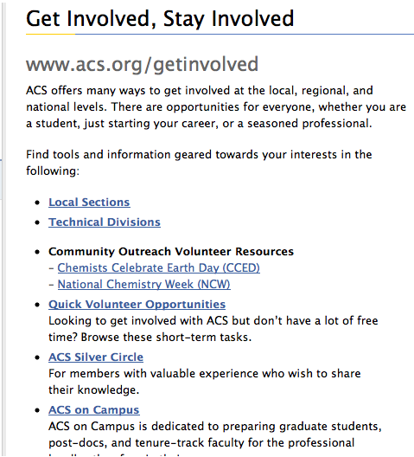
OTHER ACS RESOURCES
Use the ACS FREE service—Webs.com—to develop a website
Visit the ACS Network (Volunteer Support and Engagement)
Visit www.acs.org/getinvolved (great page to bookmark )
Technology Resources Guide
Various social media accounts
Notes:
ACS provides some other resources to help get you started.
Setting up a local section website is easy using ACS FREE Service, webs.com.
Using the ACS network with your ACS login and password will lead you to more opportunities especially for engaging volunteers
Additionally, an excellent, feature rich website at www.acs.org/getinvolved has links for local section leaders and resources for community outreach volunteers.
ACS is in the process of finalizing a technology resources guide which includes service providers for email and meeting management, social media, surveying, voting and webconferencing. Look for this document to be posted on the Get Involved web page in the coming days.
Finally learn how to effectively communicate use with your members using Social Media and other electronic means members during our Friday afternoon workshop at the Leadership Institute and during the resource fair on Saturday evening.

Slide 30
Local Section Funding Resources
Greg Milligan, Subcommittee Chair, Grants & Awards
Notes:
Greg Milligan is the continuing Chair of the LSAC subcommittee on Grants & Awards

Slide 31
LSAC GRANTS & AWARDS
Administer the Innovative Program Grant (IPG) Program through two cycles (Spring and Fall)
Administer the Local Section Science Café Mini-Grant and the Members Engaging Through Technology Grant programs.
Review and revise current grant and award procedures, as needed
Review and identify finalists and winners for all Local Section ChemLuminary Awards

Slide 32
LSAC GRANTS & AWARDS
  Innovative Program Grants (IPG) - $3,500 maximum
  Science Café Minigrants - $500 maximum
  Member Engaging Through Technology- $1500 maximum
  Review local section annual reports for local section ChemLuminary Awards

Slide 33
Leadership Institute Goals
Pre-Leadership Institute Webinar: Preparing You to be a Successful Chair/Officer
Jason Ritchie, 2018 LSAC Chair
Notes:
Let me talk for the final part of this webinar about the goals of the 2018 Leadership Institute that we will be attending next week.
I am looking forward to meeting you and have the committee members share our best information about healthy and successful local sections.

Slide 34
2018 LEADERSHIP INSTITUTE GOALS
The goal of the 2018 Leadership Institute is to support and enhance the creation of ACS leaders. Attendees will have the opportunity to:
Learn the responsibilities of a new volunteer role
Share best practices
Develop leadership and management skills
Engage with other attendees to foster new peer-to-peer networks
Notes:
One of the best parts of the Leadership Institute is that during the slightly less than 48 hours that we will be together, you will be interacting with a host of other leaders, not just from local sections, but also from ACS divisions, committees of various types and national ACS positions.
I really hope that this broad cross section of people present will enable you to have fun and productive conversations about the ACS AND your professional and personal lives, and that you can make new connections and be more inspired in your new leadership roles.
Also, on Saturday you will have the opportunity to enhance your skills by taking two leadership courses from the ACS Leadership Development System.

Slide 35
2018 LOCAL SECTION TRACK GOALS
Provide local section chair-elects and leaders with
  tools and resources to be successful
  provide examples of successful activities
  an opportunity to generate ideas about an activity and develop it
  instruction on using social networking in your local section
  how to obtain help and what grants are available
  a forum to connect with other local sections leaders
  a venue to discuss common concerns and how to measure your successes
  networking opportunities to identify and evaluate best practices from other section leaders and ACS staff
Notes:
In our Local Section Track on Friday and Sunday, we are going to provide you with tools and resources to help you be successful in your leadership roles.
You can expect to hear specific examples of projects that have worked in local sections,
You will be developing initial plans for a program in your section, and will work to develop those activities, and potentially find local collaborators and co-hosts.
Ideas and Best Practices for using Social Media communications in your local section
a forum for local section officers to connect with ACS volunteers from their neighboring local sections
a venue to discuss and address common concerns and successes
networking opportunities to identify and evaluate best practices from other section leaders and ACS staff

Slide 36
LOCAL SECTION EVENTS DURING
THE LEADERSHIP INSTITUTE
  FRIDAY
    Optional Lunch (Noon)
    Get Acquainted/Network with Sections in Your Region: Team Project (starts at 1:30 PM!)
    LSAC Welcome and Introduction
    Workshops (smaller group activities):
    Share Your Story
    SATURDAY
      Leadership Development System Course –homework for the Engaging and Motivating Volunteers course—Volunteer Motivational Factors inventory sheet
      ACS Resource Fair
      SUNDAY
        Team Project: Pulling It Together
        Collaborative Projects Report
        Town Hall Meeting
Everyone: | 2 out of 3:
Planning Successful Activities (90 min.) | Funding (40 min.) Social Media Strategies (40 min.) Communicating with Your Members (40 min.)
Notes:
Here are the major features of the Leadership Institute weekend.
We will be spending part of Friday afternoon together in a session to get acquainted starting at 1.30pm.
The bulk of the afternoon will be taken up by some excellent workshops – you will attend 2 of 3 that are offered – to get you prepared to lead your local section in whichever way you have been chosen.
We will be together after dinner too for a fast moving evening where we hear from local section leaders who have successfully accomplished award winning activities in a feature we call “Share Your Story”.
Then on Saturday, you will be taking Leadership Development Courses, and attending the ACS Resource Fair
We will next all be together on Sunday, where we will ask teams to pull together their project and activity ideas and share what they developed.
One of the key parts that the committee members like to work on is answering your questions and
we will wrap up with a Q&A at the Town Hall Meeting.

Slide 37
YOUR HOMEWORK
BE PREPARED for the Leadership Institute
  Bring an event idea to the Leadership Institute
    One that you are considering for your year as chair; or,
    Think of an activity/event that could be planned in collaboration with neighboring local sections. Identify past regional/joint/collaborative events/activities to share with your colleagues.
Notes:
OK, here’s your Homework!
We ask that in preparation for the Leadership Institute, you come with a local section event idea that you are working on, or that could be held collaboratively with neighboring geographic sections
This might be an activity that you are considering running during your year as Chair!
You’ll have an opportunity to work with Local Section leaders that are geographically close to yours, and we hope that you can use this as an opportunity to develop collaborative programming ideas.
Your idea doesn’t have to be a final plan, as you will be continuing to develop your idea as you move through the Leadership Institute weekend.

Slide 38
Thank You for Participating!
2018 Pre-Leadership Institute Webinar: Leading Your ACS Local Section
Additional Questions?
Jason Ritchie, Chair LSAC
Tracy Hamilton, Subcommittee Chair O&S
Ellen Stechel, Subcommittee Chair T&T
Charles Cannon, Subcommittee Chair Communications
Greg Milligan, Subcommittee Chair Grants & Awards
Mark O’Brien, Staff Liaison LSAC
Notes:
Thank you for participating in this 2018 Pre-Leadership Institute Webinar.
Thank you Tracy, Ellen, and Greg, and on behalf of the Local Section Activities Committee, we are looking forward to meeting you in Dallas next week
And we would be happy to answer your questions about this presentation.
Mark are there any questions from the chat line?

