Slide 1
Questions or
Comments?
Type them into the
questions box!
“Why am I muted?”
Don’t worry. Everyone is muted except the Presenter and the Host. Thank you and enjoy the show.

Slide 2
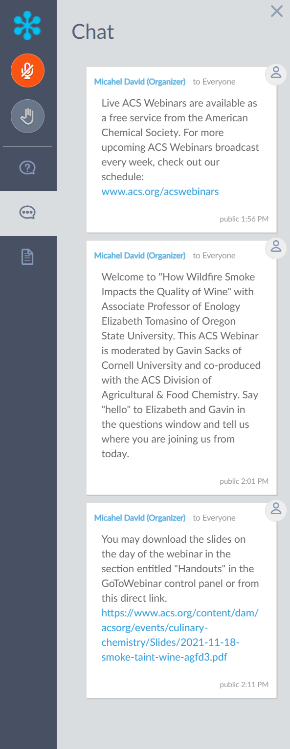
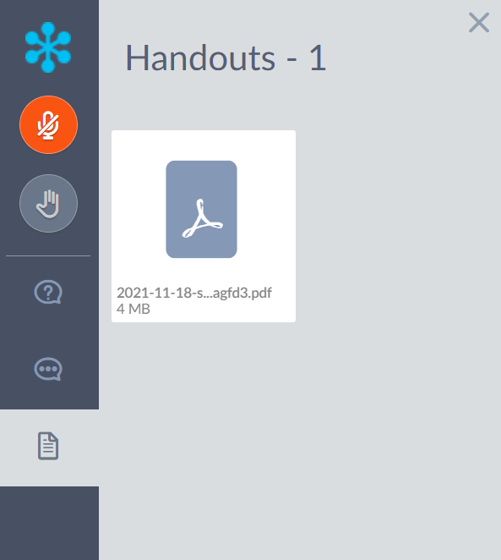
Chat
Announcements and
hyperlinks from our team
Handouts
Download the PDF of
today’s slide deck

Slide 3
Let’s Get Social!
Follow the American Chemical Society on Twitter, Facebook, Instagram, and LinkedIn for the latest news, events, and connect with your colleagues across the Society.
@AmerChemSociety
@AmericanChemicalSociety
@amerchemsociety
linkedin.com/company/
american-chemical-society
Contact ACS Webinars® at acswebinars@acs.org

Slide 4
Where is the Webinar Recording?
www.acs.org/acswebinars
All Registrants
ACS Members w/Premium Package
Watch the unedited recording linked in the Thank You Email for 24 hours.
Visit the ACS Webinars® Library to watch the edited and captioned recording.

Slide 5
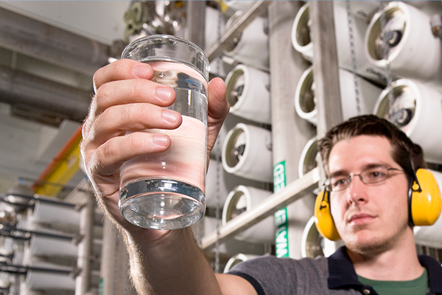
TOMORROW!
TOMORROW!
TOMORROW!
Wed., April 26, 2022 | 2pm – 3pm ET
Wed., May 4, 2022 | 2pm – 3pm ET
Thurs., May 5, 2022 | 2pm – 3:30pm ET
¿Cómo Ser Empresaria de la Industria Química?
Hydrogen Fuel to Solar Cells
and Beyond
Polymer Science in Water Purification Membranes
Co-produced with Sociedad Química de México and Chemical & Engineering News
Co-produced with CAS, a division of the American
Chemical Society
Co-produced with the ACS Division of Polymer Chemistry
Register for Free
Browse the Upcoming Schedule at www.acs.org/acswebinars

Slide 8
A Career Planning Tool For Chemical Scientists
ChemIDP is an Individual Development Plan designed specifically for graduate students and postdoctoral scholars in the chemical sciences. Through immersive, self-paced activities, users explore potential careers, determine specific skills needed for success, and develop plans to achieve professional goals. ChemIDP tracks user progress and input, providing tips and strategies to complete goals and guide career exploration.
https://chemidp.acs.org

Slide 9
Career Consultant Directory
ACS Member-exclusive program that allows you to arrange a one-on-one appointment with a certified ACS Career Consultant.
Consultants provide personalized career advice to ACS Members.
Browse our Career Consultant roster and request your one-on-one appointment today!
www.acs.org/careerconsulting

Slide 10
Notes:
Option 1
ABCChem Call for Papers is Open! The Organizing Societies of the Atlantic Basin Conference on Chemistry is accepting abstracts for the upcoming conference to be held in Marrakech, Morocco, 13-16 December 2022. The deadline to submit is 4 April. Submit today! #ABCChem2022 https://abcchem.org/
Option 2
Discover how we’re Linking the World through Chemistry at ABCChem 2022.
#ABCChem2022 Learn more at abcchem.org.
Option 3
ABCChem 2022 “Linking the World Through Chemistry” Call for Papers is now open. Submission deadline is 4 April. Learn more! #abcchem2022

Slide 11
ACS Career Resources
https://www.acs.org/content/acs/en/careers/personal-career-consulting.html
https://www.acs.org/content/acs/en/careers/developing-growing-in-your-career.html

Slide 12
TOMORROW!
TOMORROW!
TOMORROW!
Wed., April 26, 2022 | 2pm – 3pm ET
Wed., May 4, 2022 | 2pm – 3pm ET
Thurs., May 5, 2022 | 2pm – 3:30pm ET
¿Cómo Ser Empresaria de la Industria Química?
Hydrogen Fuel to Solar Cells
and Beyond
Polymer Science in Water Purification Membranes
Co-produced with Sociedad Química de México and Chemical & Engineering News
Co-produced with CAS, a division of the American
Chemical Society
Co-produced with the ACS Division of Polymer Chemistry
Register for Free
Browse the Upcoming Schedule at www.acs.org/acswebinars

Slide 13
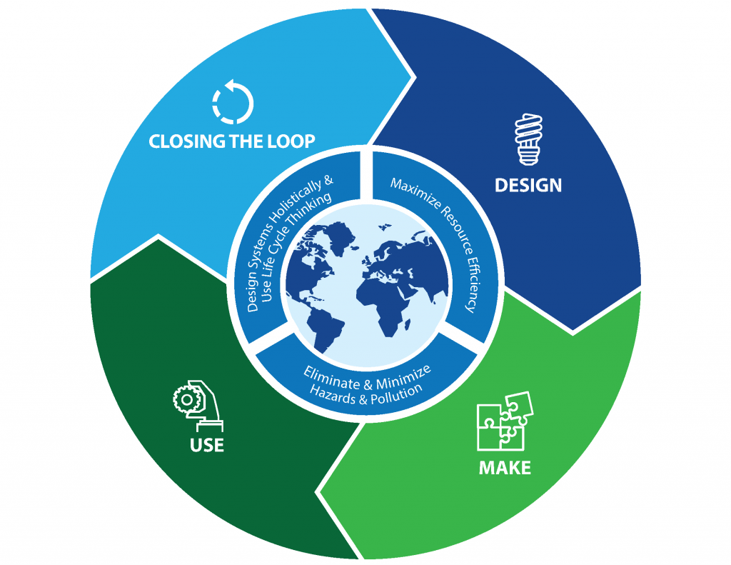
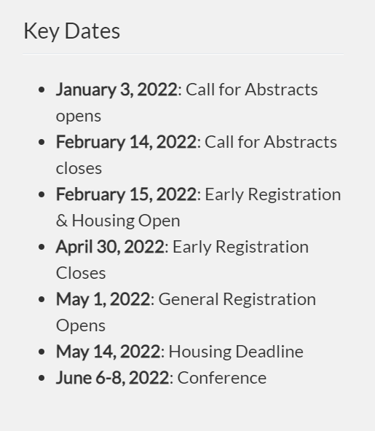
In order to highlight the importance of this approach to chemistry and engineering and to facilitate critical discussions on these topics, the theme of each GC&E Conference focuses on one of the stages of the chemical life cycle; put simply: Design, Make, Use, and Closing the Loop.
https://www.gcande.org

Slide 14
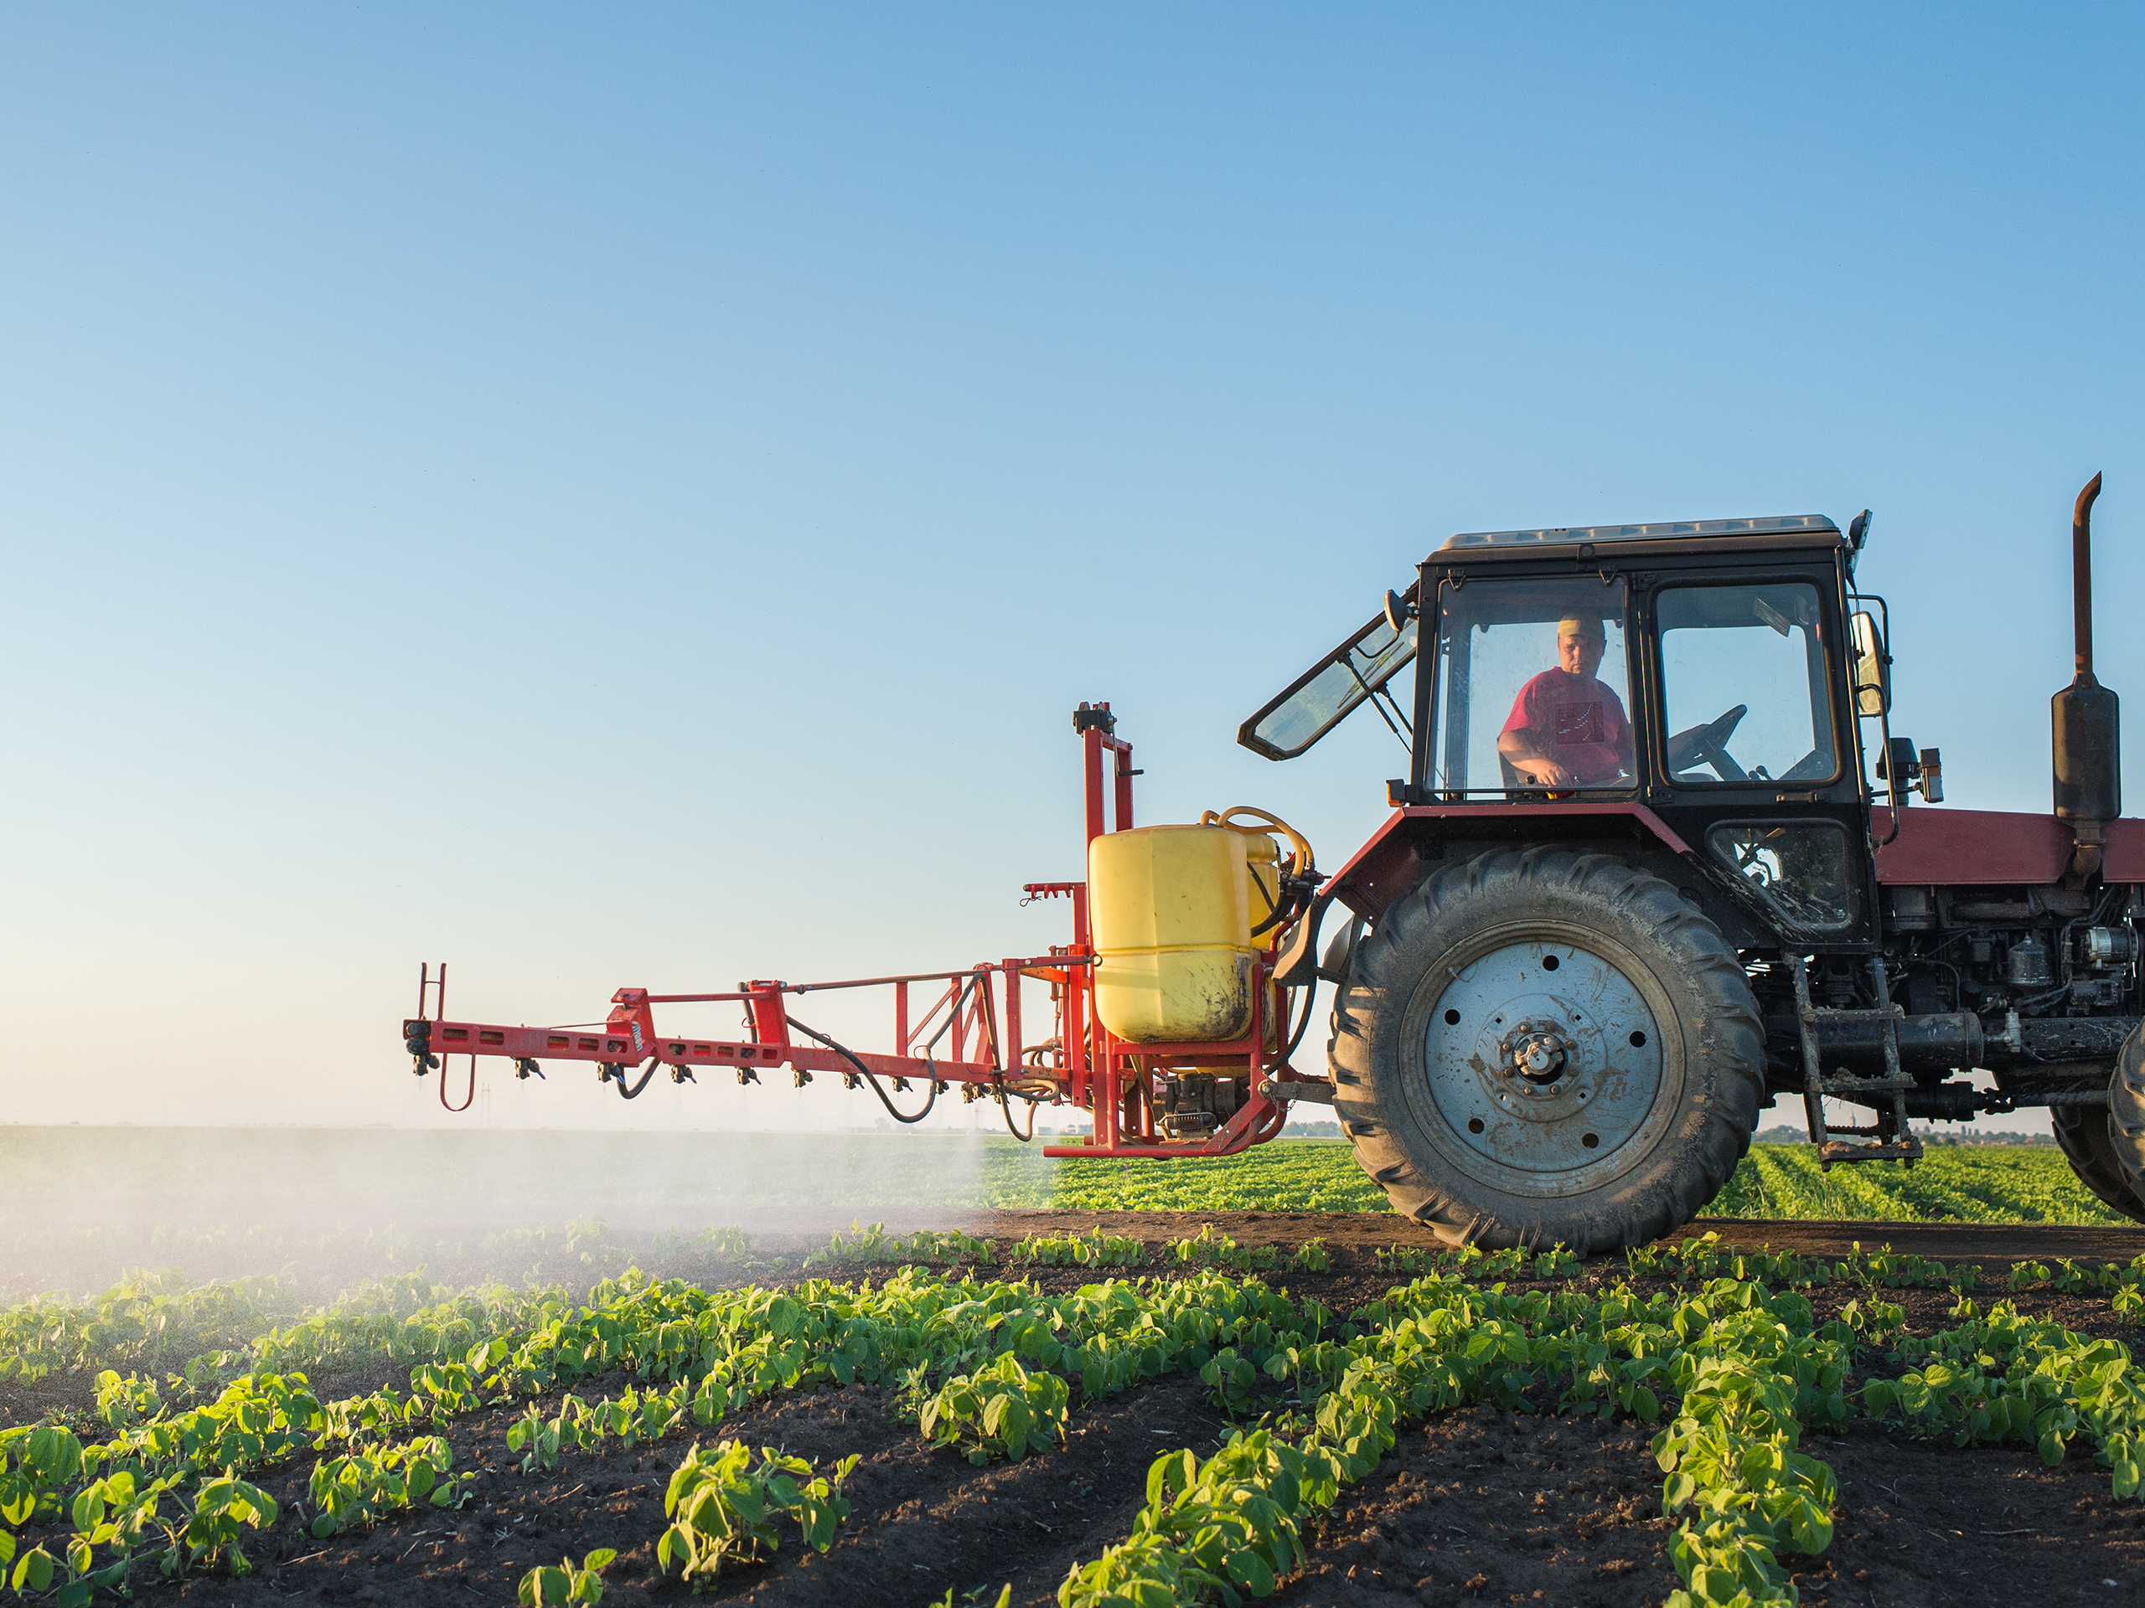
www.acs.org/acswebinars
THIS ACS WEBINAR®
WILLBEGIN SHORTLY…
🖐 Say hello in the
questions window!
14

Slide 15
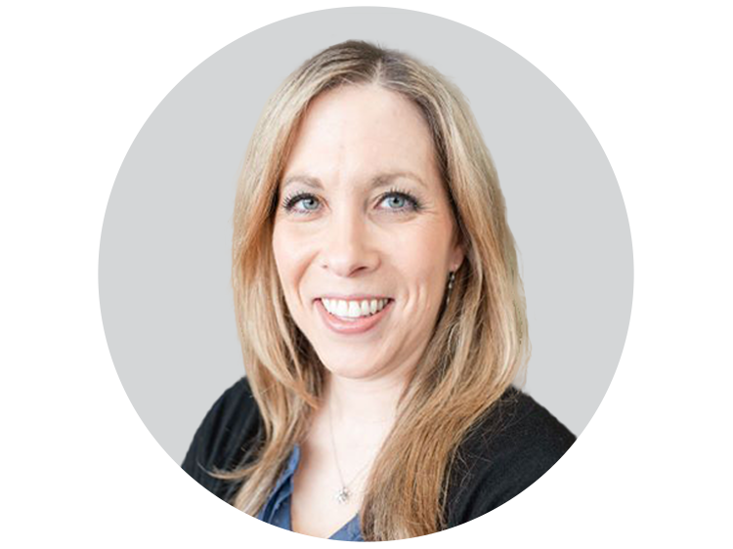
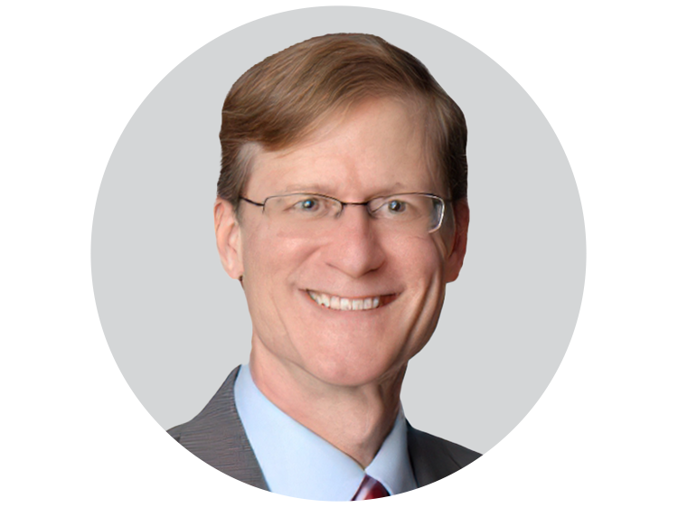
New Sustainable Crop Protection: The Pursuit of Synthetic Spinosyn Mimics
NATALIE GIAMPIETRO, Ph.D.
DAVID CONSTABLE, Ph.D.
Leader of Enabling Capabilities and Project Leader in Small Molecule Discovery and Development, Corteva AgriSciences
Science Director, Green Chemistry Institute, American Chemical Society
This ACS Webinar® is co-produced with ACS Green Chemistry Institute.

Slide 16
New Sustainable Crop Protection: The Pursuit of Synthetic Spinosyn Mimics
Natalie C. Giampietro
Gary D. Crouse*, David Demeter, Thomas C. Sparks*
*Research Fellow (retired)
Corteva Agriscience, Crop Protection Discovery Research
Indianapolis, Indiana
ACS April 2022

Slide 17
What You Will Learn
What are the driving forces creating opportunities for innovation in crop protection
How Corteva incorporates sustainability into their discovery process
The story of the natural product spinosyn insecticides and the pursuit of synthetic spinosyn mimics

Slide 18
By 2050, Global Demand for Food Will Double
According to the Food and Agricultural Organization of the United Nations
Population by 2050 will exceed 9 billion
World per capita income is rising
Growing middle class
Demand for high quality protein is increasing
Population shift to cities
Even today, >840 million people are undernourished
Over the next 40 years, we need to produce as much food as humans raised in the previous 5000 years combined
Approved for External Release

Slide 19
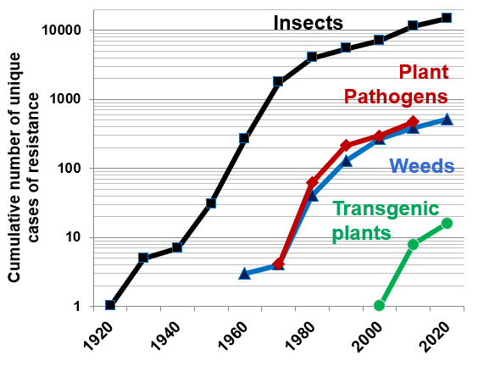
Options for Pest Control: An Expanding Array
Drivers for New Crop Protection Compounds
Pheromones
Increased Global Demand for Food >9 Billion People in 2050
Pest Resistance to Available Crop Protection Compounds
Biological control
beneficial insects
pathogens
RNAi sprayable*
Biologics
Application technology
Control Options
Crop protection compounds
Cumulative number of unique cases of resistance
Autocidal
control
Transgenic plants
Cultural control
Crop rotation
Host plant resistance
* = possible, but not yet implemented
Adapted, in part, Sparks & Lorsbach 2017 ACS Symp. Ser.
Data derived, in part, Arthropod Pesticide Resistance Database, 2020, Dr. Davide Mota-Sanchez, MSU, Heap 2019, International Herbicide-Resistance Database 2020, FRAC 2020, Tabashnik & Carriere Nat. Biotech 2017
Approved for External Release

Slide 20
Options for Pest Control: An Expanding Array
Drivers for New Crop Protection Compounds
Pheromones
Increased Global Demand for Food >9 Billion People in 2050
Pest Resistance to Available Crop Protection Compounds
Climate Change - Pest Shifts & New Pests
Changing Grower Needs
Consumer / Public Perceptions - Concerns Over the Environment
Changing Regulatory Requirements – Loss of Existing Products
Biological control
beneficial insects
pathogens
RNAi sprayable*
Biologics
Application technology
Control Options
Crop protection compounds
Autocidal
control
Transgenic plants
Cultural control
Crop rotation
Host plant resistance
* = possible, but not yet implemented
Adapted, in part, Sparks & Lorsbach 2017 ACS Symp. Ser.
Approved for External Release

Slide 21
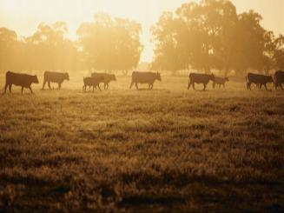
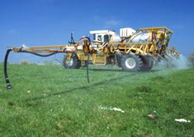
Audience Survey Question
ANSWER THE QUESTION ON THE INTERACTIVE SCREEN IN ONE MOMENT
What is the average time and cost to bring a new crop protection molecule to market?
5 years, 27 million
3 years, 58 million
11 years, 325 million
15 years, 100 million
* If your answer differs greatly from the choices above tell us in the chat!

Slide 22
Options for Pest Control: An Expanding Array
Average Time & Cost Required to Bring a New Molecule to Market
Pheromones
2010-2014: 11.3 years, $286 million (~$325 million 2020)
Biological control
beneficial insects
pathogens
RNAi sprayable*
Biologics
Application technology
Control Options
Crop protection compounds
Autocidal
control
1967: 5 years
$3.4 million (= $27 million 2020)
Transgenic plants
Cultural control
Crop rotation
Host plant resistance
* = possible, but not yet implemented
Adapted, in part, Sparks & Lorsbach 2017 ACS Symp. Ser.
Data, in part, from Sparks & Lorsbach Pest Manag. Sci.. 2017
Approved for External Release

Slide 23
Lessons Learned:
The driving forces creating opportunities for innovation in crop protection include:
Increased Global Demand for Food
Pest Resistance to Available Crop Protection Compounds
Climate Change - Pest Shifts & New Pests
Changing Grower Needs
Consumer / Public Perceptions
Changing Regulatory Requirements
Bringing a new crop protection molecule to market takes time and is costly, but is critical to continue to support the global demand for food in the future
Approved for External Release

Slide 24
Crop Protection Discovery - Where to Start?
Corteva’s commitment to sustainability
Discovery of crop protection compounds
Impact of natural products (NPs)
Where can NPs take us
Examples from the spinosyns
N
W
E
S

Slide 25
Notes:
TALKING POINTS:
Our 2030 sustainability goals create a sustainable future.
Building trust is critical to agriculture’s long-term success. Trust with consumers, external stakeholders, and customers.​
​
Farming is full of uncertainty. Making long-term sustainability investments today reduce risk and help anticipate and react to economic, social, environmental, and regulatory changes.​
​
Sustainability grows demand by increasing business growth, and opening up new markets for our customers and for us. It drives innovations to increase yield, optimize inputs, and expand the solutions we offer to farmers.​
​

Slide 27
R&D Sustainable Innovation
Every newly developed Corteva Agriscience innovation from our pipeline will meet our sustainability criteria by 2025
Sustainability assessed and tracked at every stage and applies to all pipeline projects
Approved for External Release

Slide 28
Audience Survey Question
ANSWER THE QUESTION ON THE INTERACTIVE SCREEN IN ONE MOMENT
What factors may be important to consider when developing sustainable crop protection products? (Select all that apply)
Mammalian Toxicology
Ecotoxicology
Environmental Risk and Exposure
Bioaccumulation
None of the Above
* If your answer differs greatly from the choices above tell us in the chat!

Slide 29
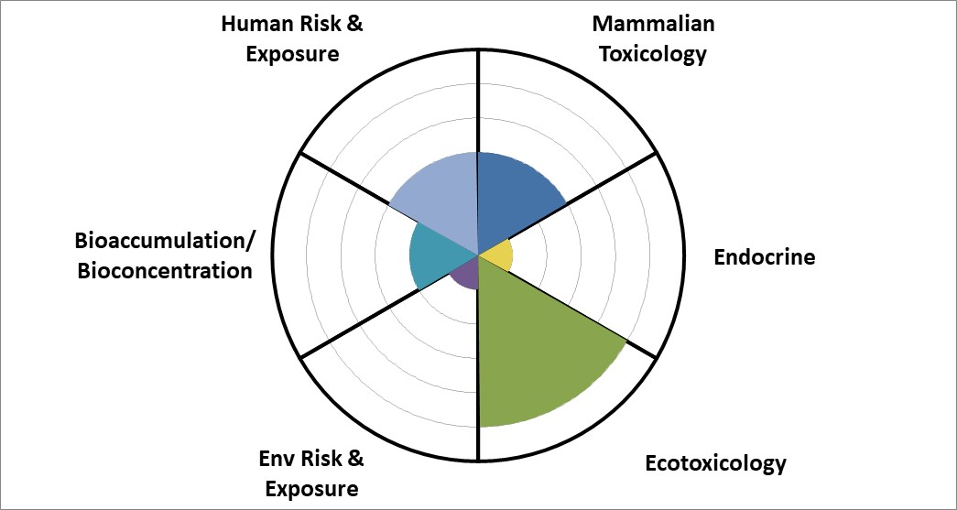
Predictive Safety Center Sustainability Footprint Diagram
Translates sustainability goals into tool to inform decision-making
Smaller Pie = Lower Hazard
Scoring References:
Worst case = 36
Medium case = 18
Best case = 6

Slide 30
Crop Protection Discovery - Where to Start?
Patents, Literature, Competitor inspired chemical space
Screens Hits
Actives - Leads – Phases
Products
Novel Scaffolds, Ligand-based, Target site, Shape-based, Scaffold hopping, Diversity & Fragment-based, 3rd Party inputs, Data mining, Ag-like / Chem-based ideas
Natural products
Semi-synthetics
NP-inspired
Synthetic biology
Loso et al. Pest Manag. Sci. 2017
Lorsbach et al. Pest Manag. Sci. 2019
Approved for External Release

Slide 31
Crop Protection Discovery - Where to Start?
Patents, Literature, Competitor inspired chemical space
Within a company - further exploration of internal product chemistry
Screens Hits
Actives - Leads – Phases
Products
Novel Scaffolds, Ligand-based, Target site, Shape-based, Scaffold hopping, Diversity & Fragment-based, 3rd Party inputs, Data mining, Ag-like / Chem-based ideas
Natural products
Semi-synthetics
NP-inspired
Synthetic biology
Loso et al. Pest Manag. Sci. 2017
Lorsbach et al. Pest Manag. Sci. 2019
Sparks et al. Pestic. Biochem. Physiol. 2019
Approved for External Release

Slide 32
Crop Protection Discovery - Where to Start?
Patents, Literature, Competitor inspired chemical space
Within a company - further exploration of internal product chemistry
Screens Hits
Actives - Leads – Phases
Novel Scaffolds, Ligand-based, Target site, Shape-based, Scaffold hopping, Diversity & Fragment-based, 3rd Party inputs, Data mining, Ag-like / Chem-based ideas
Natural products
Semi-synthetics
NP-inspired
Synthetic biology
Origins of Historic & Recent
Insecticides
n = 322 Data from Agranova 2020
Approved for External Release

Slide 33
Approaches to Exploring and Exploiting NPs
Screening
New Natural Product
Naturally occurring analogs
Synthetic mimics
New organisms making different analogs
Genetic engineering organism / synthetic biology
Semi-synthesis
Highlight several of these approaches using the spinosyn natural products as examples
Adapted from Sparks et al. Modern Crop Protection Compounds, 2019
Approved for External Release

Slide 34
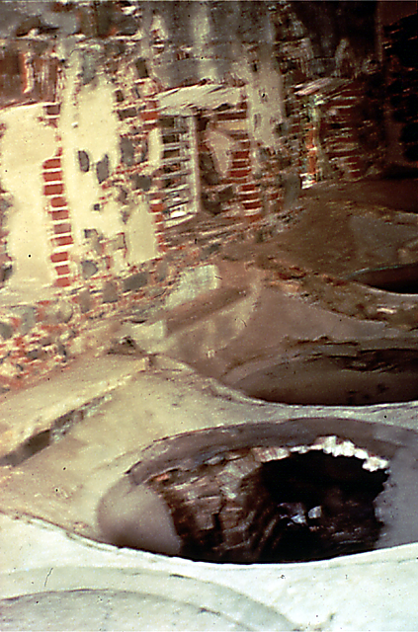
Discovery of Spinosad- QalcovaTM active
Screening
Eli Lilly & Co. NP Discovery Program
1982 – Lilly NP chemist vacationing in Virgin Islands - soil sample abandoned rum still
1983-4 - fermentation extracts inactive for antibiotic & anti-helmenthic activity
1983 – New 96-well mosquito larvicide assay – increased throughput & higher sensitivity
1985 – Soil sample (A83543) from Virgin Islands active in mosquito bioassay - new organism (Saccharopolyspora spinosa)
Thompson et al. 2000 Pest. Sci. 56, 696
Approved for External Release

Slide 35
Discovery of Spinosad- QalcovaTM active
Forosamine
5 Years
Spinosad 1997- QalcovaTM active
– Mixture of:
Major component spinosyn A, R₆ = H
Minor component spinosyn D, R₆ = CH₃
Screening
5 years to isolate, determine structure
Rhamnose
Novel macrolide - 12-member macrocyclic ring as part of a tetracycle – two sugars attached
As insecticidally active as the best insecticides at the time (synthetic pyrethroids)
Very low toxicity to mammals, birds, and fish; short environmental persistence; excellent IPM fit, minimal effects on natural enemies
Registered in 1997 under US EPA’s Reduced Risk Pesticide Initiative
1999 Presidential Green Chemistry Award – 2003 USDA Organic Status
Novel mode of action – insect nicotinic acetylcholine receptor allostertic site– IRAC Group 5
Thompson et al. 2000 Pest. Sci. 56, 696
Approved for External Release

Slide 36
Next Generation Spinosyn
Goals - new spinosyn product
Improved activity overall
Expanded spectrum
Improved residual
Further exploration of
internal product chemistry
Screens Hits
Actives - Leads – Phases
Spinosad - QalcovaTM active
Natural products
Semi-synthetics
NP-inspired
Synthetic biology
Approved for External Release

Slide 37
Further Exploration of the Spinosyns
Spinosad - QalcovaTM active
Screening
Naturally occurring analogs
Synthetic mimics
New organisms making different analogs
Genetic engineering organism / synthetic biology
Semi-synthesis
Approved for External Release

Slide 38
Further Exploration of the Spinosyns
Spinosad - QalcovaTM active
Screening
Naturally occurring analogs
Synthetic mimics
New organisms making different analogs
Genetic engineering organism / synthetic biology
Semi-synthesis
Approved for External Release

Slide 39
Further Exploration of the Spinosyns
Spinosad - QalcovaTM active
Screening
Naturally occurring analogs
modify enone
Rhamnose: modify, replace or remove
Semi-synthesis
For several years – unable to improve on spinosad / spinosyn A
Over 10 years >1200 analogs
Systematic replacement and substitution
Classic QSAR – no success
forosamine: remove or
modify basicity or size
of alkyl substituents
alkylation at C-2
oxidations or reductions of double bond
oxidations of the allylic
methyl group
Approved for External Release

Slide 40
Next Generation Spinosyn - Application of AI-Based QSAR
Spinosad - QalcovaTM
active
Inspiration:
Frank Jenkins’
“Homer Hoover
Robotic vacuum cleaner”
March 1993
Discover Magazine
Screening
Artificial Neural Network - based Quantitative Structure Activity Relationships
Can AI be used to predict an improved spinosyn?
10x more active than spinosyn A
Sparks et al. Pest Manag. Sci. 2001, Sparks et al. J. Comput. Aided Mol. Des. 2008
Approved for External Release

Slide 41
Conceptual Pathway to Discovery of Spinetoram
Spinosad (1997) - QalcovaTM active
Screening
Artificial Intelligence (ANN) based QSAR
Traditional SAR
Improved photostability
Spinetoram
(2007)
ANN-based QSAR
Improved insecticidal activity
major component R = H, 5,6 = single bond
minor component R = CH₃ , 5,6 = double bond
Sparks et al. J. Comput. Aided Mol. Des. 2008
Approved for External Release

Slide 42
Spinetoram- JemvelvaTM active
Launched in 2007
Improved efficacy
Expanded spectrum
Improved residual activity in the field
Favorable mammalian and environmental toxicological profile
DELEGATE™ WG
25% (250 gai/kg) water-dispersable granule
Tree fruits, tree nuts, bush berries, cane berries, grapes
RADIANT™ SC
1 lb ai/gallon (120 gai/L) suspension concentrate
Vegetables, strawberries, herbs, agronomic crops
major component R = H, 5,6 = single bond
minor component R = CH₃ , 5,6 = double bond
2008
™Trademark of Dow AgroSciences LLC.
Delegate WG and Radiant SC are not fully registered for sale or use in all states.
Sparks et al. J. Comput.Aided Molec. Des. 2008, Dripps et al. in Green Trends in Insect Control 2011, Galm & Sparks J. Ind. Microbiol. Biotechnol. 2016
Approved for External Release

Slide 43
Lessons Learned:
Corteva is committed to development of sustainable crop protection products
There are important factors to consider when developing sustainable crop protection products, including:
Mammalian Toxicology
Ecotoxicology
Environmental Risk and Exposure
Bioaccumulation
The discovery of Spinosad (QalcovaTM active) led to further investigations resulting in Spinetoram (JemvelvaTM active), with both products receiving EPA Green Chemistry Awards
Approved for External Release

Slide 44
Audience Survey Question
ANSWER THE QUESTION ON THE INTERACTIVE SCREEN IN ONE MOMENT
Is it possible to take a complex natural product like spinosad and design a fully synthetic mimic?
Yes
No
Not sure
* If your answer differs greatly from the choices above tell us in the chat!

Slide 45
Further Exploration of the Spinosyns
Spinosad - QalcovaTM active
Screening
Naturally occurring analogs
Synthetic mimics
New organisms making different analogs
Genetic engineering organism / synthetic biology
Semi-synthesis
Altered physical properties
More insecticidal
Altered spectrum
Totally synthetic
Lower cost
Small synthetic mimic
Spinosad
Approved for External Release

Slide 46
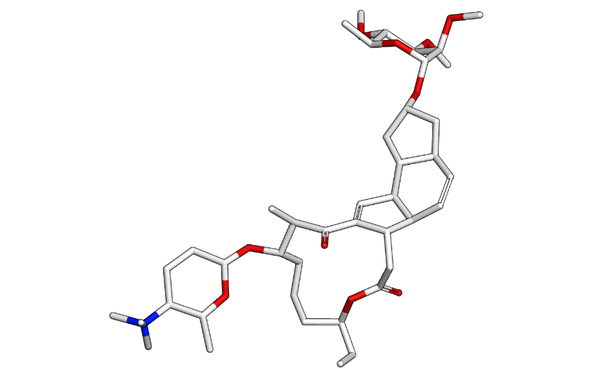
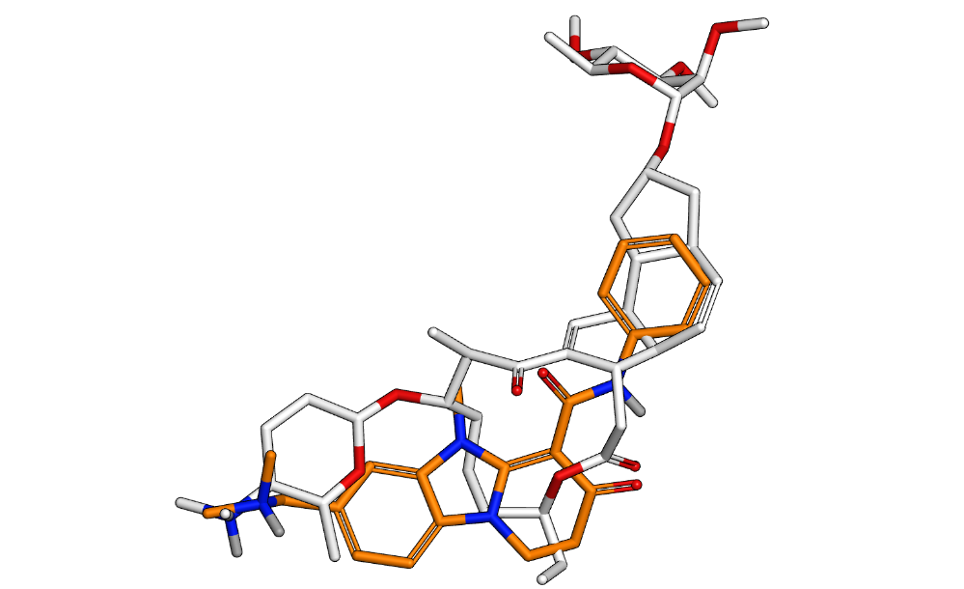
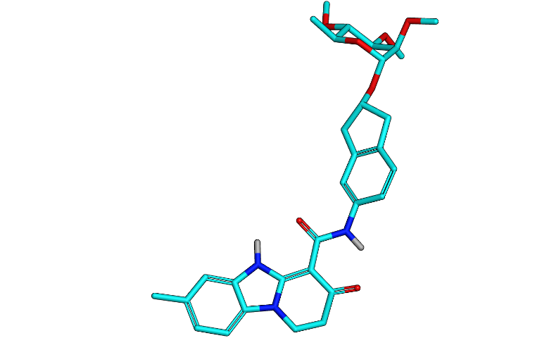
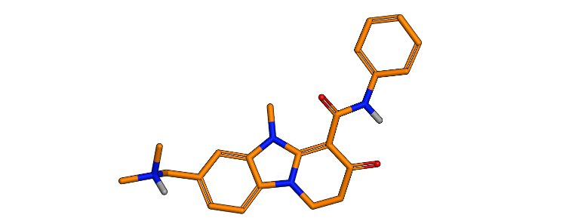
Building a New Insecticide - Spinosyn Synthetic Mimics
Spinosad – mixture of
spinosyn A, R₆ = H
spinosyn D, R₆ = CH₃
19
PBI-based macrocycle replacement
Can the whole macrocycle be replaced with a simpler structure?
Computer-Aided Molecular Design & Modeling
Crouse et al. Sci. Reports 2018
Sparks et al. Pest Manag Sci. 2019, 75, 309-313
Pyridobenzimidazole (PBI) - core
Approved for External Release

Slide 47
Spinosyn Synthetic Mimics – Evolution
Inactive in vivo
21
19
22
23
24
25
>12.5
S.e. LC₅₀
H.z. LC₅₀
26
Spinosad
Spinetoram
27
19 21 22 23 24 25 26 27
Sparks et al. Pest Manag Sci. 2019, 75, 309-313
Approved for External Release

Slide 48
Spinosyn Synthetic Mimics – Evolution
Rhamnose Substitution SAR
Beet armyworm diet assay
μg/cm²
23
24
25
23 24 spinosad spinetoram
Tracksprayer - UV Stability
Beet armyworm diet assay
26
24
>10
Beet Armyworm LC₅₀ ug/cm²
26
25
Oxime Carbamate
Sparks et al. Pest Manag Sci. 2019, 75, 309-313
Approved for External Release

Slide 49
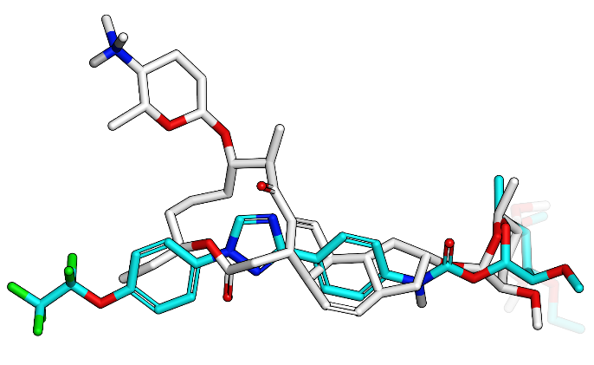
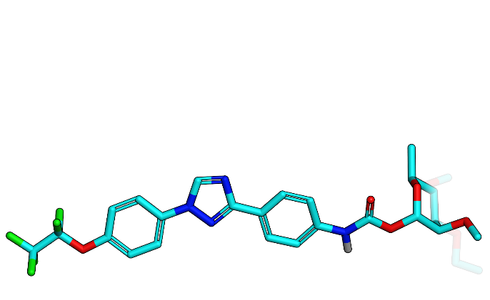
Synthetic Spinosyn Mimic – Overlay with Spinosyn A
Spinosyn A
Overlay of Spinosyn A & a synthetic spinosyn mimic
Synthetic spinosyn mimic - 26
Unlike spinosyns, the forosamine appears unnecessary for the synthetic spinosyn mimics
Modified from Crouse et al. Sci Reports 2018, Sparks et al. Pest Manag. Sci. 2019, 75, 309-313
Approved for External Release

Slide 50
Cabbage looper on Broccoli Fresno, CA 10 DAA - counts
Field Efficacy - Spinosyn Mimic
Lepidopteran Complex Control in Soybean - Brazil.
27
* *
* *
Sparks et al. Pest Manag. Sci. 2019, 75, 309-313, Sparks ACS 2019
Approved for External Release

Slide 51
Pathway to Spinosyns & Spinosyn Mimics
6 years
NP screening
Product
Spinosad (1997) - QalcovaTM
AI-QSAR based
Semi-synthesis
Spinetoram (2007) - JemvelvaTM
Natural
Products
Classical QSAR
Genetic Algorithms
5 years
Sparks et al. 2008 J. Comp-Aid Molec Des. 22, 393
Sparks et al. 2001 Pest Manag. Sci. 57, 896
Sparks et al. 2020 Pest Manag. Sci. - submitted
Thompson et al. 2000 Pest. Sci. 56, 696
Learnings from spinosyn SAR
Computer-Aided Molecular Design
Further Molecular Modeling & Bioactivity Directed Synthesis
7 years
Photostable triaryl spinosyn mimic
Crouse et al. 2018 Sci. Reports, 8-4861
Sparks et al. 2019 Pest Manag. Sci. 75, 309
Sparks et al. 2020 Pest Manag. Sci. - submitted
The intersection between Biology, Chemistry and Computational tools (AI, QSAR, CAMD) has been Key to understanding and exploiting of this family of natural products
Approved for External Release

Slide 52
Summary
There are driving forces creating opportunities for innovation in crop protection
Corteva incorporates sustainability into the discovery process towards new crop protection solutions
The story of the natural product spinosyn insecticides and the pursuit of synthetic spinosyn mimics exemplifies:
Natural Products have been and remain an excellent source and inspiration for new crop protection compounds
“Nature inspired and built by humans”
Even complex macrolide NPs can be simplified
Computational tools can open the door to new possibilities
The discovery pathway is challenging….but fun!
Ask a different question. Be persistent. Innovate. Collaboration is key
Approved for External Release

Slide 53
Thanks to Corteva Agriscience Colleagues
Management
Vid Hegde
Beth Lorsbach
Bill Kleschick
Cliff Gerwick
Jeff Nelson
Tom Meade
Dan Kittle
Mark Zettler
Frank Burroughs
Kirk Dietz
Biology
Tom Sparks
Frank Wessels
Ricky Hunter
Cathy Young
Tom Worden
John Herbert
Alice Mietl
Monica Olsen
Gerry DeBoer
Paul Schmitzer
Larry Larson
Margaret Kempe
Lenny Dintenfass
Bob Cicchillo
Paul Schmitzer
Mark Hertlein
Laura Karr
Amy Griffin
Melissa Harris
Brian Waldman
Mary Rushton
Abi Balachandran
And many more …
Biochemistry
Jerry Watson
Chaoxian Geng
Ken Beavers
Jim Hasler
David Young
Gary Gustafson
Joel Sheets
John Skomp
CP Chang
Naliah Orr
Vince Salgado (BASF)
Chemistry
Mike Loso
Bill Lambert
Gene Tisdell
Carl DeAmicis
Erich Braun
Lindsey Horty
Zoltan Benko
Jeff Webster
Mark Pobanz
John Daeuble
Kristy Bryant
Anne Buysee
Chris Lowe
Lori Lawler
Jim Turner
Tony Trullinger
Ben Nugent
Larry Creemer
Negar Garizi
Peter Johnson
Tom Barger
Bob Gajewski
Mary Pieczko
Jeff Epp
Denise Cudworth
And many more..
CAMD
Dave Demeter
Nick Wang
Greg Durst (Lilly)
Dan Pernich
Debby Camper
James Ruiz
Regulatory
Mingming Ma
Sean Gehen
Nick Simmons
Bruce Hautmann
John Cuff
Guomin Shan
Vince Kramer
Corteva
Carl Corvin
Gary Thompson
Paul Lewer
Don Hahn
CW Arnette
Kirk Brewseter
Ronda Hamm
Nick Storer
Paige Oliver
Paul Graupner
Neil Kirby
John Fitt
Ken Racke
David Rauch
Anne Gregg
Margaret Hentz
External
Rob Bryant (Agranova)
David Mota-Sanchez (MSU)
Herb Kirst (Lilly)
Trent Perry (U Melbourne, AU)
Jon Mynderse (Lilly)
Richard Baltz (Lilly)
Bruce Hammock (UC Davis)
John Casida (UC Berkeley)
Steve Duke (USDA / Ole Miss)
John Clark (U Mass)
Eddie Chio (Elanco)
IRAC
Field & Business
Greg Hanger
Luis Gomez
Mike Shaw
Jim Dripps
Kent Davies
Don Kelley
Jamey Thomas
Jon Babcock
Chris Longhurst
Imre Mezei
Tim Hassinger
Santosh Mangalam
Doris Paroonagian
Melissa Seibert
Chemistry
Gary Crouse
Natalie Giampietro
Geno Samaritoni
Casey McLeod
Jaeck Martynow
Pete Anzeveno
Jim Hunter
Ron Hackler
Tim Johnson
Diana Reeves
Randy Erickson
Yu Zhang
Marty Walsh
Jessica Herrick
Annette Brown

Slide 54
Additional Resources
https://www.corteva.com/sustainability
Part 1: The Exceptional Story of Spinosyns - Qalcova™ active
https://www.youtube.com/watch?v=gT4wMoNMqP4
Part 2: The Exceptional Story of Spinosyns - Jemvelva™ active
https://www.youtube.com/watch?v=MG5c35FimEs
Review: The spinosyns, spinosad, spinetoram, and synthetic spinosyn mimics - discovery, exploration, and evolution of a natural product chemistry and the impact of computational tools. Sparks, T. C.; Crouse, G. D.; Benko, Z.; Demeter, D.; Giampietro, N. C.; Lambert, W.; Brown, A. V, Pest Manag. Sci., 2021, 77, 3637-3649.
Discovery of highly insecticidal synthetic spinosyn mimics – CAMD enabled de novo design simplifying a complex natural product. Sparks, T. C.; Crouse, G. D.; Demeter, D.; Samaritoni, G.; McLeod, C. L. Pest Manag. Sci. 2019, 75, 309-313.

Slide 55
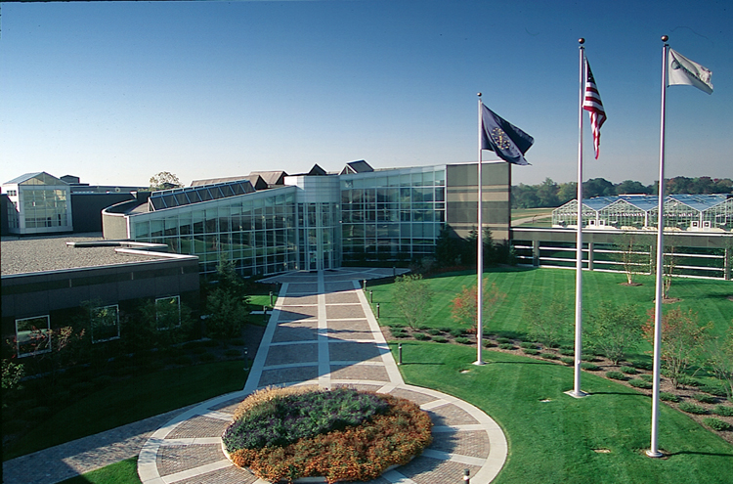
Thank You

Slide 56
NPs as a Source of Crop Protection Products
Abamectin
major component R = CH₂CH₃
minor component R = CH₃
Natural Product (NP)
NP - Products
NP - Derivatives
NP
inspiration
NPs – what
could have
been
NP Derivative (NPD)
Afidopyropen
(Meiji / BASF)
Pyripropen A
NP Synthetic Mimic (NPM)
Pyrethrin I
lambda-Cyhalothrin
NP Synthetic Equivalent (NPSE)
//
Adapted from Sparks et al. Pest Manag. Sci. 2017
Nicotine Epibatidine
Imidacloprid

Slide 57
Family of Spinosyns
Spin | NR1” | NR2” | R6 | R16 | R21 | R2’ | R3’ | R4’ | TBW LC₅₀ (ppm)
A | Me | Me | H | Me | Et | Me | Me | Me | 0.3
B |  | H |  |  |  |  |  |  | 0.4
C | H | H |  |  |  |  |  |  | 0.8
D |  |  | Me |  |  |  |  |  | 0.8
E |  |  |  | H |  |  |  |  | 4.6
F |  |  |  |  | Me |  |  |  | 4.5
H |  |  |  |  |  | H |  |  | 5.7
J |  |  |  |  |  |  | H |  | >80
K |  |  |  |  |  |  |  | H | 3.5
L |  |  | Me |  |  |  | H |  | 26
M |  | H |  |  |  |  | H |  | 23
N |  | H | Me |  |  |  | H |  | 40
O |  |  | Me |  |  |  |  | H | 1.4
P |  |  |  |  |  |  | H | H | >64
Q |  |  | Me |  |  | H |  |  | 0.5
R |  | H |  |  |  | H |  |  | 14.5
S |  |  |  |  | Me | H |  |  | 53
Y |  |  |  |  | Me |  |  | H | 20
Screening
>20 naturally occurring spinosyns.
>210-fold difference in activity between spinosyn A and the least active analogs (J, P, W, etc.)

Slide 58
Cross-Resistance of Spinosyn Mimics: Dα6 and Pxα6 mutants
26 R = ethyl
27 R = n-prop
Fruit fly - Drosophila melanogaster
Diamondback moth - Plutella xylostella
RR = 1850 3000 2450 1513 1.9
RR = 311 139 123 259 0.3
Sparks et al. Pest Manag. Sci. 2019, Sparks ACS 2019

Slide 59
In order to highlight the importance of this approach to chemistry and engineering and to facilitate critical discussions on these topics, the theme of each GC&E Conference focuses on one of the stages of the chemical life cycle; put simply: Design, Make, Use, and Closing the Loop.
https://www.gcande.org

Slide 60
www.acs.org/acswebinars
THE LIVE Q&A IS
ABOUT TO BEGIN!
Keep submitting your questions
in the questions window!
60

Slide 61
TOMORROW!
TOMORROW!
TOMORROW!
Wed., April 26, 2022 | 2pm – 3pm ET
Wed., May 4, 2022 | 2pm – 3pm ET
Thurs., May 5, 2022 | 2pm – 3:30pm ET
¿Cómo Ser Empresaria de la Industria Química?
Hydrogen Fuel to Solar Cells
and Beyond
Polymer Science in Water Purification Membranes
Co-produced with Sociedad Química de México and Chemical & Engineering News
Co-produced with CAS, a division of the American
Chemical Society
Co-produced with the ACS Division of Polymer Chemistry
Register for Free
Browse the Upcoming Schedule at www.acs.org/acswebinars

Slide 62
Learn from the best and brightest minds in chemistry!
Hundreds of webinars on a wide range of topics relevant to chemistry professionals at all stages of their careers, presented by top experts in the chemical sciences and enterprise.
Edited Recordings
are an exclusive benefit for ACS Members with the Premium Package and can be accessed in the
ACS Webinars® Library at www.acs.org/acswebinars
Live Broadcasts
of ACS Webinars® continue to be available free to the general public several times a week generally from 2-3pm ET. Visit www.acs.org/acswebinars to register* for upcoming webinars.
*Requires FREE ACS ID

Slide 63
ACS Webinars® does not endorse any products or services. The views expressed in this presentation are those of the presenter and do not necessarily reflect the views or policies of the American Chemical Society.
Contact ACS Webinars® at acswebinars@acs.org

