Slide 1
Diversifying ACS Committees
Subcommittee on Diversity
Committee on Committees (ConC)

Slide 2
Committee on Committees (ConC)
ConC is responsible for:
Coordinating agendas and meetings times of Committees
Recommending assignment of petition reviews
Oversee succession planning of committee chairs, members, associates, and consultants
ConC Subcommittee on Diversity is responsible for:
Recommending methods to diversify the membership of ACS committees
Monitoring the ACS committee member pipeline and striving for geographic balance as well as diversity
Recruiting individuals from underrepresented communities within the ACS including: industrial chemists, women, racial & ethnic minorities, LGBTQ+, young & senior scientists/engineers
Notes:
c. Committee on Committees
(1) The duties of the Committee on Committees shall include:
(a) acting for the Council in the selection of Council-related SOCIETY bodies by assisting and advising in the appointment of the Chairs and members of such SOCIETY bodies; (6/10/78) (b) studying and making recommendations to the Council concerning the responsibilities and size of all Council-related SOCIETY bodies, including proposals to disband, create, or merge them; (6/10/78)
(c) coordinating the agenda and meeting times of the Standing Committees of the Council and Society Committees and assuring adequate exchanges of views on issues of general concern; (1/1/78)
(d) making recommendations on the assignment of substantive responsibility to committees for review of petitions to amend the Constitution and Bylaws; (11/19/74)
(e) appointing members to fill vacancies that have existed longer than sixty (60) days on Council-related SOCIETY bodies whose members or Chairs are normally appointed by the President; (9/15/78)
(f) participating as members of a group which acts to fill vacancies that have existed longer than sixty (60) days on Council related SOCIETY bodies whose members or Chairs are normally appointed jointly by the President and the Chair of the Board; all members of the Executive Committee of the Board of Directors who are not appointing authorities comprise the other members of said group.

Slide 3
Why Volunteer for an ACS Committee?
Networking opportunities
With peers in industry, academia, and government
With leaders in the chemical enterprise
Development of Leadership Skills
Can be applied both at work and within the Society
Provide a sense of accomplishment
Service to your profession

Slide 4
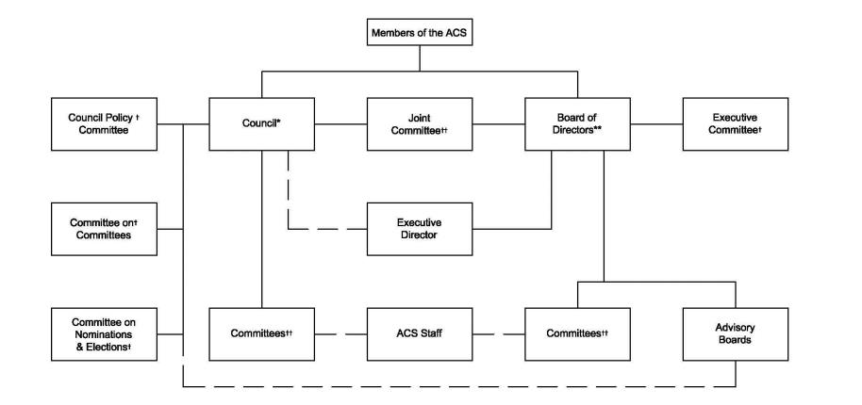
Committees Reporting to the Council
Council Committees:
Three Types: Elected, Standing, and Other
Requirement: Elected and Standing Committee Members must be Councilors

Slide 5
Committees Reporting to the Council (Standing)
Constitution & Bylaws (C&B)
Economic and Professional Affairs (CEPA)
Divisional Activities (DAC)
Local Section Activities (LSAC)
Membership Affairs (MAC)
Meetings and Expositions (M&E)
Notes:
These Committees must have a Secretary per the Bylaws
Purview of these committees is the oversight of the ongoing operations within the Society with regards to its legal framework, members, locals sections, and divisions.

Slide 6
Committees Reporting to the Council (Other)
Analytical Reagents (CAR)
Ethics (ETHICS)
Nomenclature, Terminology and Symbols (NTS)
Project SEED (SEED)
Technician Affairs (CTA)
Notes:
These committees may be established by the Council or the Council Policy Committee to serve any purposes that these two bodies determine to be appropriate.

Slide 7
Committees Reporting to both the Board and Council
Two Types: Society and Joint Board Council
Requirement: 2/3 of Society Committee Members must be Councilors

Slide 8
Committees Reporting to the Board and Council (Society)
Budget & Finance (B&F)
Education (SOCED)
Notes:
2/3 of Members must be Councilors
Must have a Secretary

Slide 9
Committees Reporting to the Board and Council (Joint Board-Council)
Chemical Abstracts Service (CCAS)
Chemical Safety (CCS)
Chemistry and Public Affairs (CCPA)
Chemists with Disabilities (CWD)
Community Activities (CCA)
Environmental Improvement (CEI)
International Activities (IAC)
Minority Affairs (CMA)
Patents and Related Matters (CP&RM)
Professional Training (CPT)
Publications (PUBS)
Public Relations and Communications (CPRC)
Science (COMSCI)
Senior Chemists (SCC)
Women Chemists (WCC)
Younger Chemists (YCC)

Slide 10
Committee Appointment Process: Members/Associates/Consultants
Request to be on committee
Keeping your Yellow Book info updated
Preference form is important: up to 3 committee preferences
Attend an open session of a committee of interest
Recommendation of others
Speak with your local section councilor
Speak with a committee chair
Speak to the ConC liaison for a committee
Recruitment to be on committee
Make recommendations of talented individuals to ConC

Slide 11
ConC Subcommittee on Diversity
Dr. Christopher J. Bannochie, S/C Chair
cj.bannochie@SRNL.doe.gov
803-725-8088
Dr. Michelle V. Buchanan
buchananmv@ORNL.gov
865-574-1144
Ms. Zaida C. Morales-Martinez
moralesmartinez@comcast.net
305-386-3206
Dr. Robert A. Pribush
rpribush@butler.edu
317-989-6799

